Slide 1
COM/BLM 376 Computer Architecture Chapter 2 Computer Evolution and Performance
Assoc. Prof. Dr. Gazi Erkan BOSTANCI
ebostanci@ankara.edu.tr
Slides are mainly based on
Computer Organization and Architecture: Designing for Performance by William Stallings, 9th Edition, Prentice Hall
<number>
Notes:
<number>

Slide 2
Outline
A Brief History of Computers
Designing for Performance
Multicore, MICs, GPGPUs
Embedded Systems
Performance Assessment
<number>

Slide 3
A Brief History of Computers
The First Generation: Vacuum Tubes
ENIAC The ENIAC (Electronic Numerical Integrator And Computer), designed and constructed at the University of Pennsylvania, was the world’s first general purpose electronic digital computer.
The resulting machine was enormous, weighing 30 tons, occupying 1500 square feet of floor space, and containing more than 18,000 vacuum tubes. When operating, it consumed 140 kilowatts of power. It was also substantially faster than any electromechanical computer, capable of 5000 additions per second.
3

Slide 4
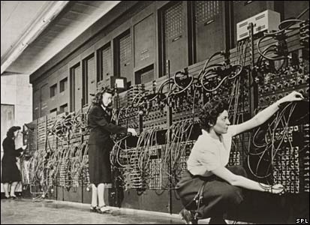
The ENIAC was a decimal rather than a binary machine. That is, numbers were represented in decimal form, and arithmetic was performed in the decimal system. Its memory consisted of 20 accumulators, each capable of holding a 10-digit decimal number. A ring of 10 vacuum tubes represented each digit.
At any time, only one vacuum tube was in the ON state, representing one of the 10 digits. The major drawback of the ENIAC was that it had to be programmed manually by setting switches and plugging and unplugging cables.
4

Slide 5
The Von Neuman Machine
The task of entering and altering programs for the ENIAC was extremely tedious.
Stored Program Concept
Suppose a program could be represented in a form suitable for storing in memory alongside the data.
Then, a computer could get its instructions by reading them from memory, and a program could be set or altered by setting the values of a portion of memory.
4

Slide 6
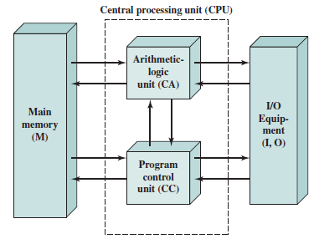
In 1946, von Neumann and his colleagues began the design of a new stored program computer, referred to as the IAS computer, at the Princeton Institute for Advanced Studies.
It consists of
A main memory, which stores both data and instructions
An arithmetic and logic unit (ALU) capable of operating on binary data
A control unit, which interprets the instructions in memory and causes them to be executed
Input/output (I/O) equipment operated by the control unit
6

Slide 7
With rare exceptions, all of today’s computers have this same general structure and function and are thus referred to as von Neumann machines. Thus, it is worthwhile at this point to describe briefly the operation of the IAS computer.
The memory of the IAS consists of 1000 storage locations, called words, of 40 binary digits (bits) each. Both data and instructions are stored there. Numbers are represented in binary form, and each instruction is a binary code.
Note that there is no universal definition for word since it depends on the instruction length for a given computer.
Each number is represented by a sign bit and a 39-bit value. A word may also contain two 20-bit instructions, with each instruction consisting of an 8-bit operation code (opcode) specifying the operation to be performed and a 12-bit address designating one of the words in memory numbered from 0 to 999).
7

Slide 8
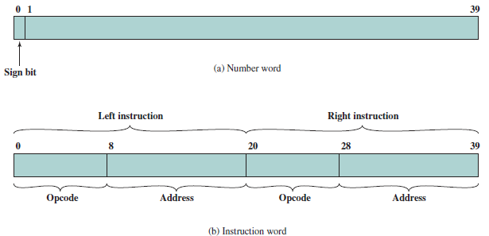
IAS Memory Formats
7

Slide 9
The control unit operates the IAS by fetching instructions from memory and executing them one at a time.
To explain this, a more detailed structure diagram is needed with the following components:
Memory buffer register (MBR): Contains a word to be stored in memory or sent to the I/O unit, or is used to receive a word from memory or from the I/O unit.
Memory address register (MAR): Specifies the address in memory of the word to be written from or read into the MBR.
Instruction register (IR): Contains the 8-bit opcode instruction being executed.
Instruction buffer register (IBR): Employed to hold temporarily the right hand instruction from a word in memory.
Program counter (PC): Contains the address of the next instruction pair to be fetched from memory.
Accumulator (AC) and multiplier quotient (MQ): Employed to hold temporarily operands and results of ALU operations.
For example, the result of multiplying two 40-bit numbers is an 80-bit number; the most significant 40 bits are stored in the AC and the least significant in the MQ.
9

Slide 10
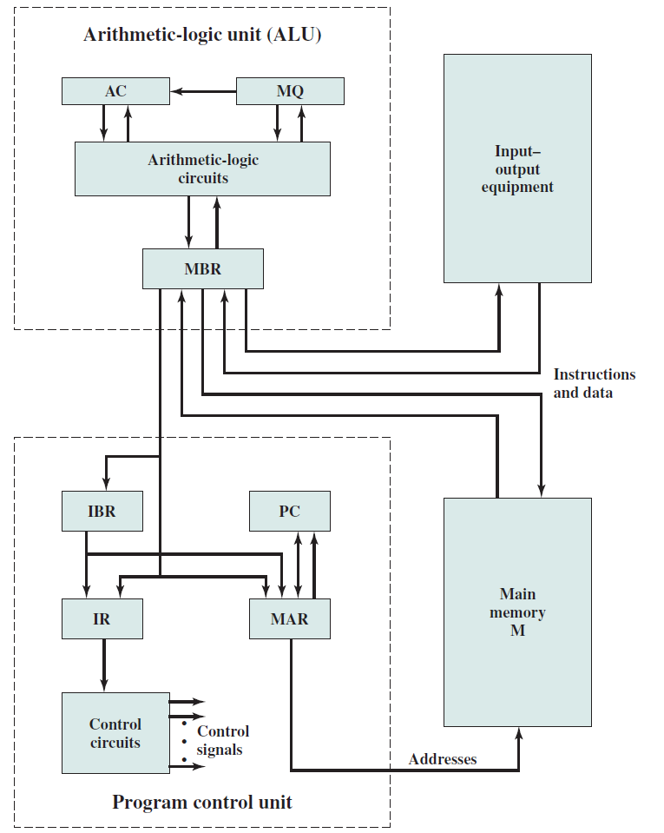
9

Slide 11
The IAS operates by repetitively performing an instruction cycle.
Each instruction cycle consists of two subcycles. During the fetch cycle, the opcode of the next instruction is loaded into the IR and the address portion is loaded into the MAR. This instruction may be taken from the IBR, or it can be obtained from memory by loading a word into the MBR, and then down to the IBR,IR, and MAR.
Once the opcode is in the IR, the execute cycle is performed.
Control circuitry interprets the opcode and executes the instruction by sending out the appropriate control signals to cause data to be moved or an operation to be performed by the ALU.
11

Slide 12
The IAS computer had a total of 21 instructions which can be grouped as follows:
Data transfer: Move data between memory and ALU registers or between two ALU registers.
Unconditional branch: Normally, the control unit executes instructions in sequence from memory. This sequence can be changed by a branch instruction, which facilitates repetitive operations.
Conditional branch: The branch can be made dependent on a condition, thus allowing decision points.
Arithmetic: Operations performed by the ALU.
Address modify: Permits addresses to be computed in the ALU and then inserted into instructions stored in memory. This allows a program considerable addressing flexibility.
12

Slide 13
Each instruction must conform to the instruction format. The opcode portion(first 8 bits) specifies which of the 21 instructions is to be executed.
The address portion (remaining 12 bits) specifies which of the 1000 memory locations is to be involved in the execution of the instruction.
Note that each operation requires several steps. Some of these are quite elaborate.
The multiplication operation requires 39 suboperations, one for each bit position except that of the sign bit.
13

Slide 14
The Second Generation: Transistors
The first major change in the electronic computer came with the replacement of the vacuum tube by the transistor. The transistor is
smaller,
cheaper, and
Dissipates less heat than a vacuum tube but can be used in the same way as a vacuum tube to construct computers.
Unlike the vacuum tube, which requires wires, metal plates, a glass capsule, and a vacuum, the transistor is a solid-state device, made from silicon.
14

Slide 15
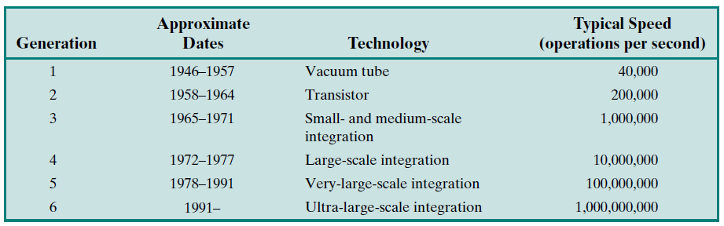
The use of the transistor defines the second generation of computers. It has become widely accepted to classify computers into generations based on the fundamental hardware technology employed. Each new generation is characterized by greater processing performance, larger memory capacity, and smaller size than the previous one.
14

Slide 16
The Third Generation: Integrated Circuits
A single, self-contained transistor is called a discrete component.
Throughout the 1950s and early 1960s, electronic equipment was composed largely of discrete components—transistors, resistors, capacitors, and so on.
Discrete components were manufactured separately, packaged in their own containers, and soldered or wired together onto circuit boards, which were then installed in computers and other electronic equipment. Whenever an electronic device called for a transistor, a little tube of metal containing a pinhead-sized piece of silicon had to be soldered to a circuit board.
The entire manufacturing process, from transistor to circuit board, was expensive and cumbersome.
In 1958 came the achievement that revolutionized electronics and started the era of microelectronics: the invention of the integrated circuit.
16

Slide 17
Microelectronics
Literally, “small electronics.” Since the beginnings of digital electronics and the computer industry, there has been a persistent and consistent trend toward the reduction in size of digital electronic circuits.
The basic elements of a digital computer, as we know, must perform storage, movement, processing, and control functions. Only two fundamental types of components are required: gates and memory cells.
A gate is a device that implements a simple Boolean or logical function, such as IF A AND B ARE TRUETHEN C IS TRUE (AND gate). Such devices are called gates because they control data flow in much the same way that canal gates control the flow of water.
17

Slide 18
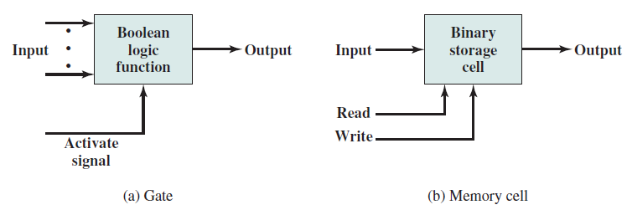
17

Slide 19
By interconnecting large numbers of these fundamental devices, we can construct a computer. We can relate this to our four basic functions as follows:
Data storage: Provided by memory cells.
Data processing: Provided by gates.
Data movement: The paths among components are used to move data from memory to memory and from memory through gates to memory.
Control: The paths among components can carry control signals. For example, a gate will have one or two data inputs plus a control signal input that activates the gate. When the control signal is ON, the gate performs its function on the data inputs and produces a data output. Similarly, the memory cell will store the bit that is on its input lead when the WRITE control signal is ON and will place the bit that is in the cell on its output lead when the READ control signal is ON.
19

Slide 20
A thin wafer of silicon is divided into a matrix of small areas, each a few millimeters square. The identical circuit pattern is fabricated in each area, and the wafer is broken up into chips. Each chip consists of many gates and/or memory cells plus a number of input and output attachment points.
This chip is then packaged in housing that protects it and provides pins for attachment to devices beyond the chip. A number of these packages can then be interconnected on a printed circuit board to produce larger and more complex circuits.
20

Slide 21
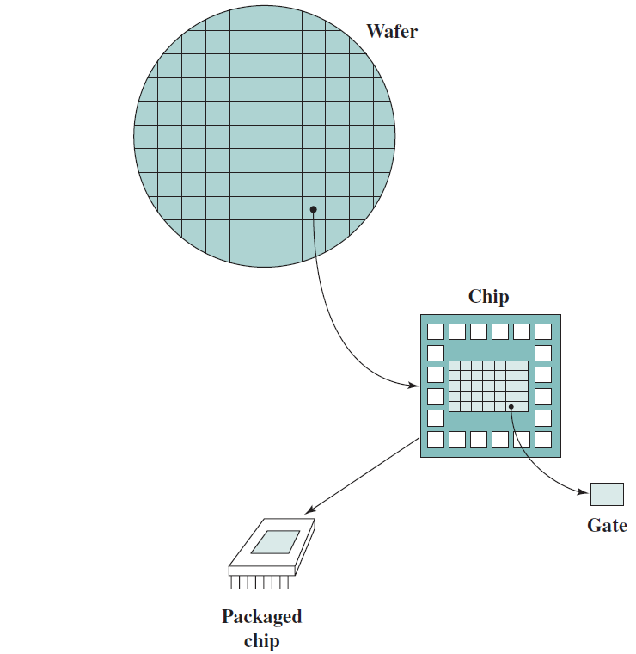
20

Slide 22
Gordon Moore (cofounder of Intel) observed that the number of transistors that could be put on a single chip was doubling every year and correctly predicted that this pace would continue into the near future.
To the surprise of many, including Moore, the pace continued year after year and decade after decade. The pace slowed to a doubling every 18 months in the 1970s but has sustained that rate ever since.
20

Slide 23
The consequences of Moore’s law are profound:
The cost of a chip has remained virtually unchanged during this period of rapid growth in density. This means that the cost of computer logic and memory circuitry has fallen at a dramatic rate.
Because logic and memory elements are placed closer together on more densely packed chips, the electrical path length is shortened, increasing operating speed.
The computer becomes smaller, making it more convenient to place in a variety of environments.
There is a reduction in power and cooling requirements.
The interconnections on the integrated circuit are much more reliable than solder connections. With more circuitry on each chip, there are fewer inter-chip connections.
23

Slide 24
MICROPROCESSORS Just as the density of elements on memory chips has continued to rise, so has the density of elements on processor chips. As time went on, more and more elements were placed on each chip, so that fewer and fewer chips were needed to construct a single computer processor.
•A breakthrough was achieved in 1971, when Intel developed its 4004. The4004 was the first chip to contain all of the components of a CPU on a single chip: The microprocessor was born.
•The 4004 can add two 4-bit numbers and can multiply only by repeated addition. By today’s standards, the 4004 is hopelessly primitive, but it marked the beginning of a continuing evolution of microprocessor capability and power.
24

Slide 25
The next major step in the evolution of the microprocessor was the introduction of the Intel 8008 in 1972. This was the first 8-bit microprocessor and was almost twice as complex as the 4004.
Neither of these steps was to have the impact of the next major event: the introduction of the Intel 8080 in 1974. This was the first general-purpose microprocessor.
About the same time, 16-bit microprocessors began to be developed. However, it was not until the end of the 1970s that powerful, general-purpose 16-bit microprocessors appeared. One of these was the 8086.
25

Slide 26
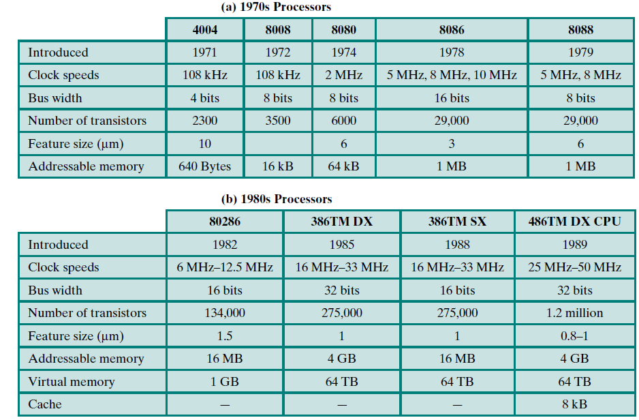
25

Slide 27
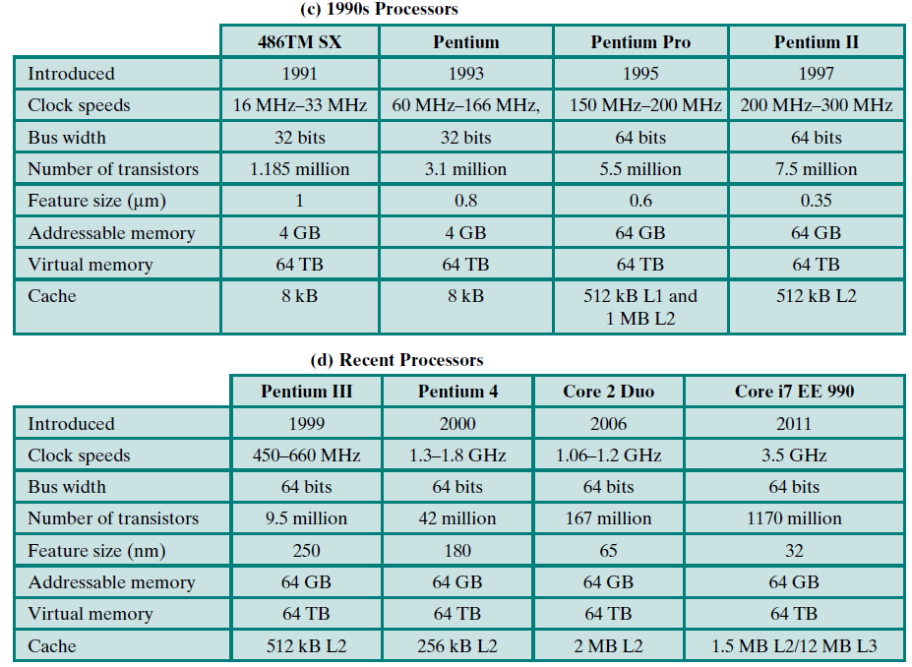
25

Slide 28
Designing for Performance
Year by year, the cost of computer systems continues to drop dramatically, while the performance and capacity of those systems continue to rise equally dramatically.
Today’s laptops have the computing power of an IBM mainframe from 10 or 15 years ago. Thus, we have virtually “free” computer power. Processors are so inexpensive that we now have microprocessors we throw away.
The digital pregnancy test as an example (used once and then thrown away).
28

Slide 29
Desktop applications that require the great power of today’s microprocessor-based systems include
Image processing
Speech recognition
Videoconferencing
Multimedia authoring
Voice and video annotation of files
Simulation modeling
Workstation systems now support highly sophisticated engineering and scientific applications, as well as simulation systems, and have the ability to support image and video applications.
In addition, businesses are relying on increasingly powerful servers to handle transaction and database processing and to support massive client/server networks that have replaced the huge mainframe computer centers of previous years.
29

Slide 30
Microprocessor Speed
What gives Intel x86 processors or IBM mainframe computers such mind-boggling power is the relentless pursuit of speed by processor chip manufacturers.
In microprocessors, the addition of new circuits, and the speed boost that comes from reducing the distances between them, has improved performance four-or fivefold every three years or so since Intel launched its x86 family in 1978.
29

Slide 31
But the raw speed of the microprocessor will not achieve its potential unless it is fed a constant stream of work to do in the form of computer instructions.
Anything that gets in the way of that smooth flow undermines the power of the processor.
Accordingly, while the chipmakers have been busy learning how to fabricate chips of greater and greater density, the processor designers must come up with ever more elaborate techniques for feeding the monster.
31

Slide 32
Among the techniques built into contemporary processors are the following:
Pipelining: With pipelining, a processor can simultaneously work on multiple instructions. The processor overlaps operations by moving data or instructions into a conceptual pipe with all stages of the pipe processing simultaneously.
For example, while one instruction is being executed, the computer is decoding the next instruction.
Branch prediction: The processor looks ahead in the instruction code fetched from memory and predicts which branches, or groups of instructions, are likely to be processed next. If the processor guesses right most of the time, it can prefetch the correct instructions and buffer them so that the processor is kept busy.
The more sophisticated examples of this strategy predict not just the next branch but multiple branches ahead. Thus, branch prediction increases the amount of work available for the processor to execute.
32

Slide 33
Data flow analysis: The processor analyzes which instructions are dependent on each other’s results, or data, to create an optimized schedule of instructions. In fact, instructions are scheduled to be executed when ready, independent of the original program order. This prevents unnecessary delay.
Speculative execution: Using branch prediction and data flow analysis, some processors speculatively execute instructions ahead of their actual appearance in the program execution, holding the results in temporary locations. This enables the processor to keep its execution engines as busy as possible by executing instructions that are likely to be needed.
33

Slide 34
Multicore, MICS and GPGPUs
The use of multiple processors on the same chip, also referred to as multiple cores, or multicore, provides the potential to increase performance without increasing the clock rate.
Studies indicate that, within a processor, the increase in performance is roughly proportional to the square root of the increase in complexity.
But if the software can support the effective use of multiple processors, then doubling the number of processors almost doubles performance. Thus, the strategy is to use two simpler processors on the chip rather than one more complex processor.
34

Slide 35
Chip manufacturers are now in the process of making a huge leap forward in the number of cores per chip, with more than 50 cores per chip. The leap in performance as well as the challenges in developing software to exploit such a large number of cores have led to the introduction of a new term: many integrated core(MIC).
The multicore and MIC strategy involves a homogeneous collection of general-purpose processors on a single chip. At the same time, chip manufacturers are pursuing another design option: a chip with multiple general-purpose processors plus graphics processing units (GPUs) and specialized cores for video processing and other tasks.
35

Slide 36
Since GPUs perform parallel operations on multiple sets of data, they are increasingly being used as vector processors for a variety of applications that require repetitive computations.
This blurs the line between the GPU and the CPU. When a broad range of applications are supported by such a processor, the term general-purpose computing on GPUs (GPGPU)is used.
35

Slide 37
Embedded Systems
A combination of computer hardware and software, and perhaps additional mechanical or other parts, designed to perform a dedicated function. In many cases, embedded systems are part of a larger system or product, as in the case of an antilock braking system in a car.
Embedded systems far outnumber general-purpose computer systems, encompassing a broad range of applications
35

Slide 38
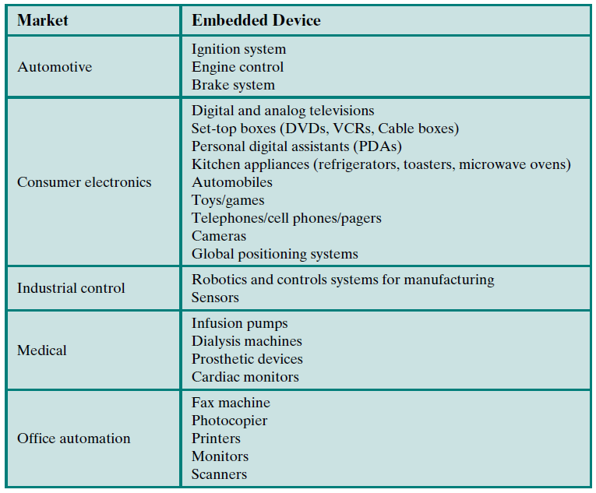
35

Slide 39
These systems have widely varying requirements and constraints, such as the following:
Small to large systems, implying very different cost constraints, thus different needs for optimization and reuse
Relaxed to very strict requirements and combinations of different quality requirements, for example, with respect to safety, reliability, real-time, and flexibility
Short to long life times
Different environmental conditions in terms of, for example, radiation, vibrations, and humidity
39

Slide 40
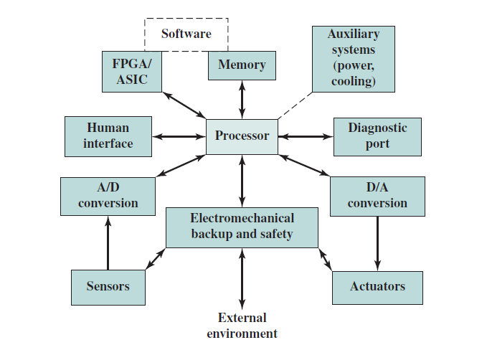
39

Slide 41
Performance Assessment
In evaluating processor hardware and setting requirements for new systems, performance is one of the key parameters to consider, along with cost, size, security, reliability, and, in some cases, power consumption.
It is difficult to make meaningful performance comparisons among different processors, even among processors in the same family. Raw speed is far less important than how a processor performs when executing a given application.
Unfortunately, application performance depends not just on the raw speed of the processor but also on the instruction set, choice of implementation language, efficiency of the compiler, and skill of the programming done to implement the application.
41

Slide 42
Clock Speed and Instructions per Second
The System Clock
Operations performed by a processor, such as fetching an instruction, decoding the instruction, performing an arithmetic operation, and soon, are governed by a system clock.
All operations begin with the pulse of the clock.
The speed of a processor is dictated by the pulse frequency produced by the clock, measured in cycles per second, or Hertz (Hz).
Typically, clock signals are generated by a quartz crystal, which generates a constant signal wave while power is applied. This wave is converted into a digital voltage pulse stream that is provided in a constant flow to the processor circuitry.
42

Slide 43
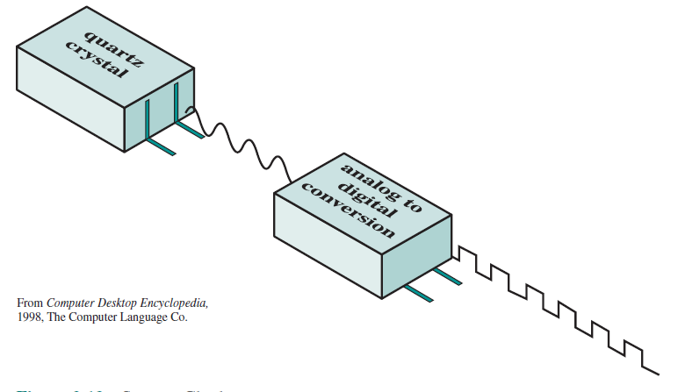
42

Slide 44
For example, a 1-GHz processor receives 1 billion pulses per second.
The rate of pulses is known as the clock rate, or clock speed. One increment, or pulse, of the clock is referred to as a clock cycle, or a clock tick. The time between pulses is the cycle time.
The clock rate is not arbitrary, but must be appropriate for the physical layout of the processor. Actions in the processor require signals to be sent from one processor element to another. When a signal is placed on a line inside the processor, it takes some finite amount of time for the voltage levels to settle down so that an accurate value (1 or 0) is available.
Furthermore, depending on the physical layout of the processor circuits, some signals may change more rapidly than others. Thus, operations must be synchronized and paced so that the proper electrical signal(voltage) values are available for each operation.
44

Slide 45
The execution of an instruction involves a number of discrete steps, such as fetching the instruction from memory, decoding the various portions of the instruction, loading and storing data, and performing arithmetic and logical operations.
Thus, most instructions on most processors require multiple clock cycles to complete. Some instructions may take only a few cycles, while others require dozens.
In addition, when pipelining is used, multiple instructions are being executed simultaneously.
Thus, a straight comparison of clock speeds on different processors does not tell the whole story about performance.
45

Slide 46
Instruction Execution Rate
A processor is driven by a clock with a constant frequency f or, equivalently, a constant cycle time t, where t = 1/f.
Define the instruction count, Ic, for a program as the number of machine instructions executed for that program until it runs to completion or for some defined time interval.
Note that this is the number of instruction executions, not the number of instructions in the object code of the program.
Think about loops.
45

Slide 47

An important parameter is the average cycles per instruction (CPI) for a program. If all instructions required the same number of clock cycles, then CPI would be a constant value for a processor.
However, on any give processor, the number of clock cycles required varies for different types of instructions, such as load, store, branch, and so on. Let CPI_{i} be the number of cycles required for instruction type i and I_{i} be the number of executed instructions of type i for a given program.
45

Slide 48

The processor time T needed to execute a given program can be expressed as
45

Slide 49

A common measure of performance for a processor is the rate at which instructions are executed, expressed as millions of instructions per second (MIPS),referred to as the MIPS rate. We can express the MIPS rate in terms of the clock rate and CPI as follows:
45

Slide 50
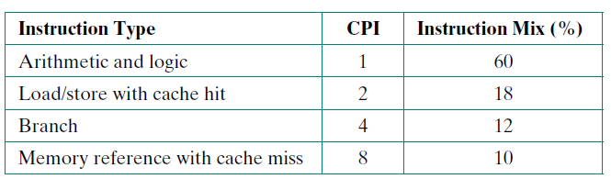
For example, consider the execution of a program that results in the execution of 2 million instructions on a 400-MHz processor. The program consists of four major types of instructions. The instruction mix and the CPI for each instruction type are given below based on the result of a program trace experiment:
45

Slide 51
The average CPI when the program is executed on a uniprocessor with the above trace results is CPI = 0.6 + (2x 0.18) + (4 x0.12) + (8 x0.1) = 2.24.
The corresponding MIPS rate is (400 x10⁶)/(2.24 x 10⁶) ≈ 178.
45

Slide 52
Amdahl’s Law
When considering system performance, computer system designers look for ways to improve performance by improvement in technology or change in design.
Examples include the use of parallel processors, the use of a memory cache hierarchy, and speedup in memory access time and I/O transfer rate due to technology improvements.
In all of these cases, it is important to note that a speedup in one aspect of the technology or design does not result in a corresponding improvement in performance. This limitation is succinctly expressed by Amdahl’s law.
52

Slide 53
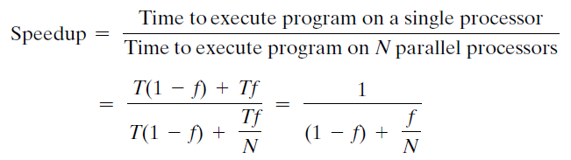
Consider a program running on a single processor such that a fraction(1 –f) of the execution time involves code that is inherently serial and a fraction f that involves code that is infinitely parallelizable with no scheduling overhead. Let T be the total execution time of the program using a single processor. Then the speedup using a parallel processor with N processors that fully exploits the parallel portion of the program is as follows:
52

Slide 54
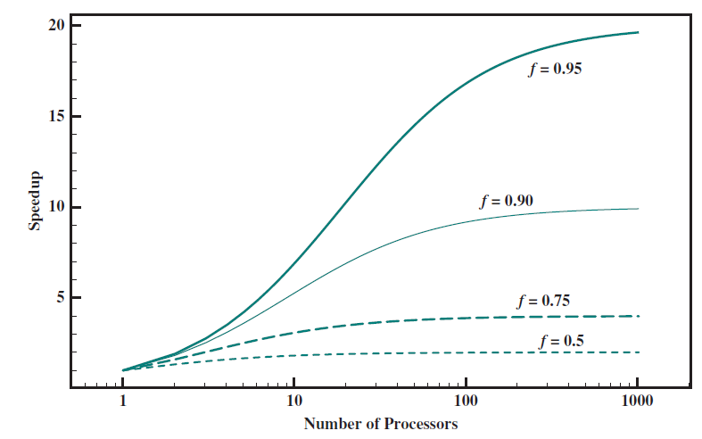
52

Slide 55
Two important conclusions can be drawn:
When f is small, the use of parallel processors has little effect.
As N approaches infinity, speedup is bound by 1/(1 –f), so that there are diminishing returns for using more processors.
52

Slide 56
Amdahl’s law can be generalized to evaluate any design or technical improvement in a computer system. Consider any enhancement to a feature of a system that results in a speedup. The speedup can be expressed as
52

